Slide 2
Culture of the 1920’s
How did cultural changes in the 1920’s reflect a turning point in America?

Slide 3
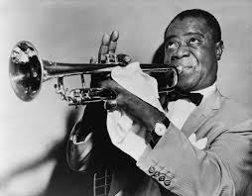
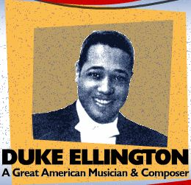
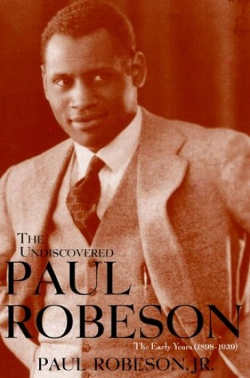
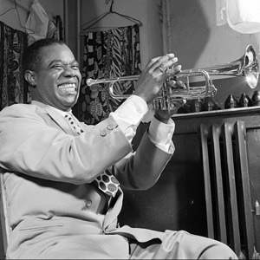
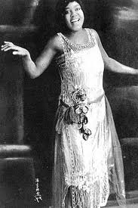
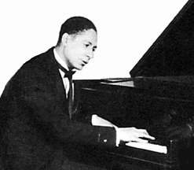
I. The Jazz Age

Slide 4
II. Consumer Society
A. Appliances, department stores, supermarkets, etc.
buy goods on credit
Woolworths, A&S, Macy’s
Electricity in the home
B. Advertising industry boomed
1. Bruce Barton: “The Man Nobody Knows”
Messages of progress, convenience, success, leisure, style, etc.
Freed up time leads Americans to seek leisure activities.

Slide 5
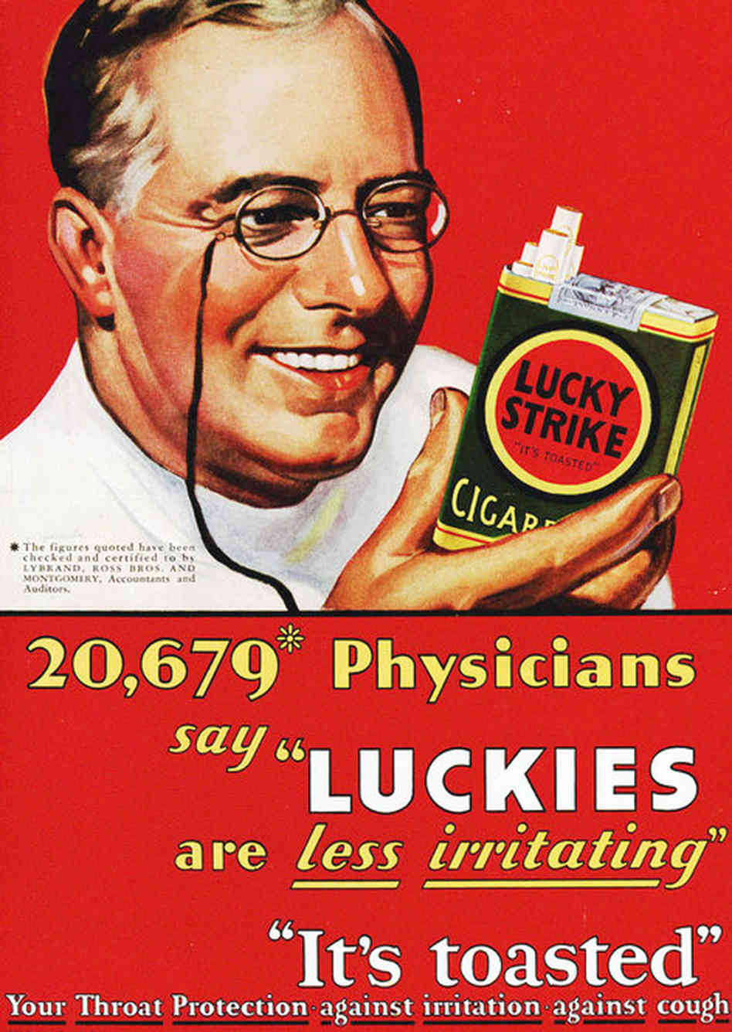

Slide 6
III. Automobiles Change Business and Society
Car sales soar by 1920s
1. People make more money & buy on credit
2. Assembly-line production lowers price by 60%
a. Frederick W. Taylor – scientific management

Slide 7
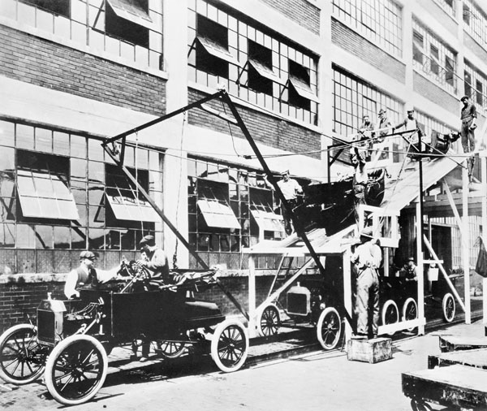
B. Autos spur growth of other industries
1. Rubber, plate glass, service stations, and gasoline

Slide 8
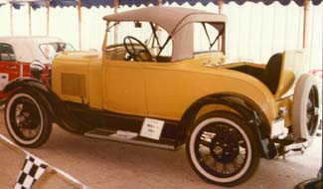

Slide 9
C. Change society and culture
Traffic jams, parking problems
Accident death rates rise sharply
Changes family life—people get away from home more often; youth culture changes
Suburban sprawl
a. people commute to work

Slide 10
D.Auto-mobiles and Societal Mores

Slide 11
“Get ‘em in the rumble seat” - 1927 song
Cars provided an opportunity for illicit romance and promiscuity
Car Manufactors created seats that would lie down like beds
Conservatives complained of the demoralizing effects on society.

Slide 12
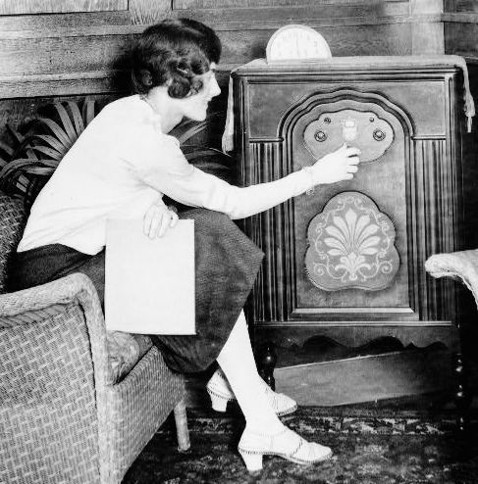
IV. Entertainment

Slide 13
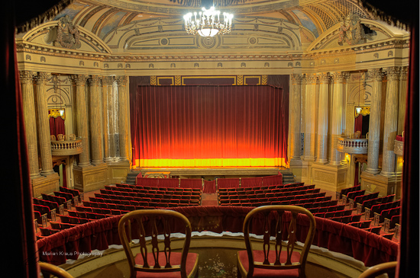
Movie Palaces

Slide 14
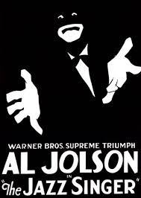

Slide 15
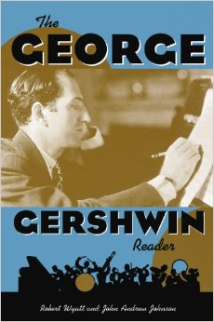
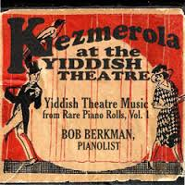
American Musical Theatre

Slide 16
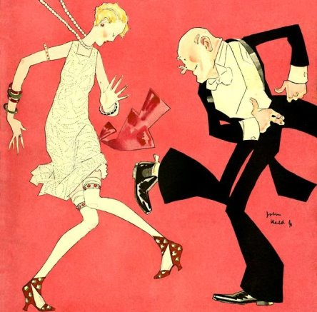
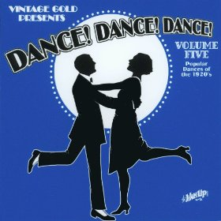
Dance Crazies
Charleston
Varsity Drag

Slide 17
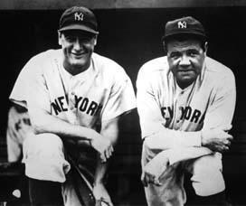
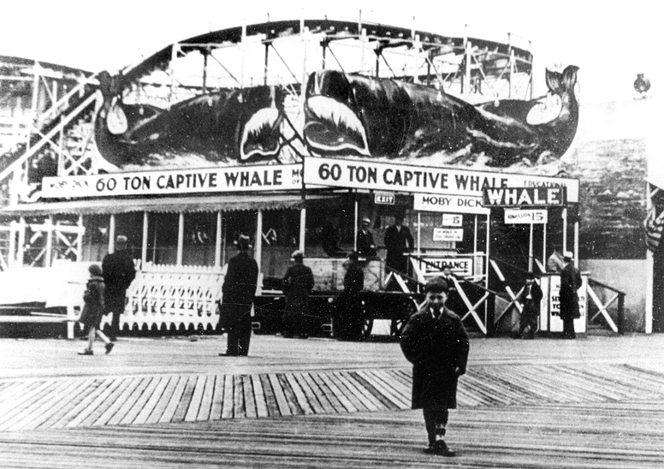
V. Popular Heroes and Spectator Sports
Baseball
Boxing
Car Racing
Coney Island Amusement Parks

Slide 18
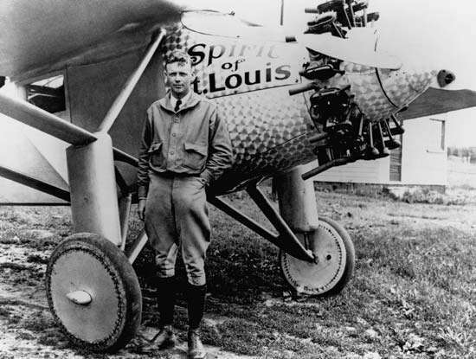
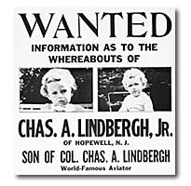
Charles Lindbergh – first one manned flight across the Atlantic
(Took off from Roosevelt Field landed in Paris)

Slide 19
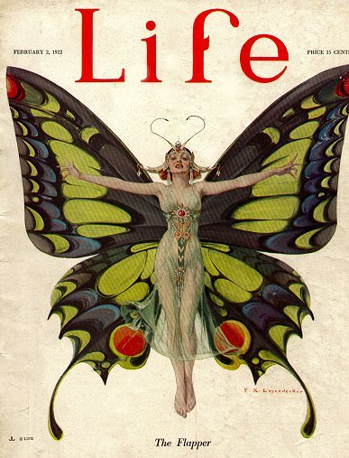
VI. Gender Roles

Slide 21
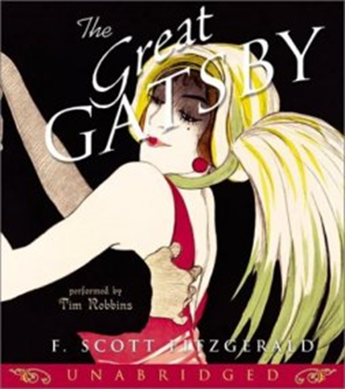
VII. The Lost Generation

Slide 22
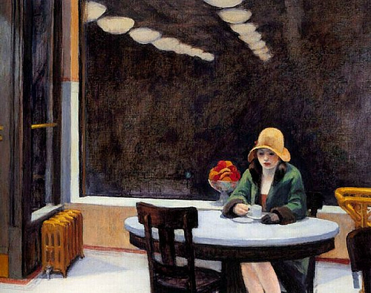
VIII. Art and Architecture

Slide 23
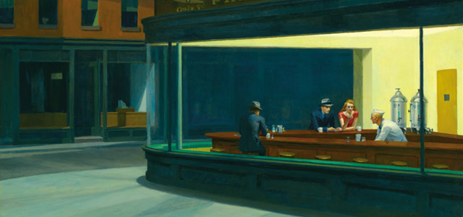
Edward Hopper

Slide 24
Joseph Steller “Brooklyn Bridge”

Slide 25
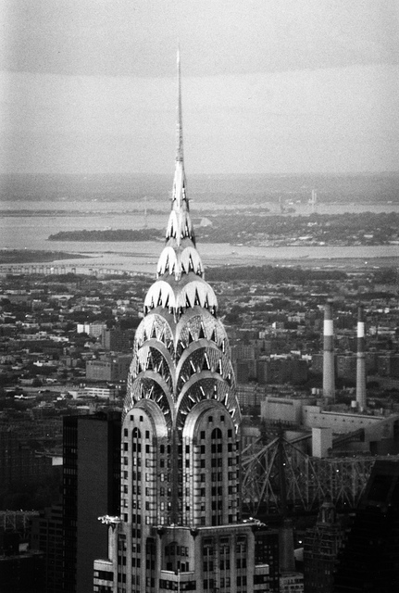
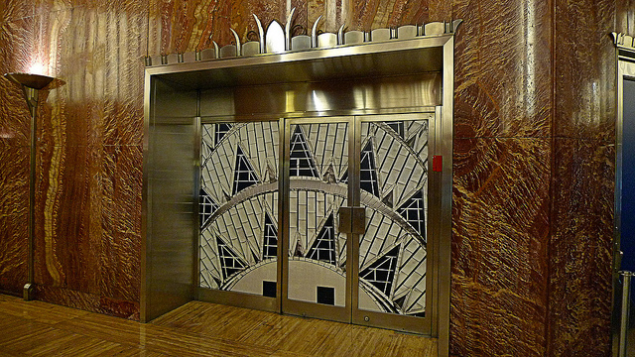
ART DECO

Slide 26
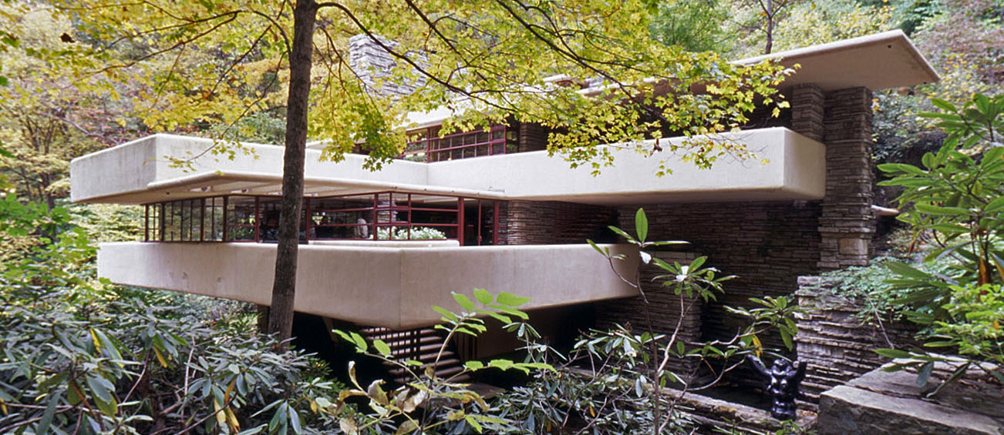
Frank Lloyd Wright

Slide 27
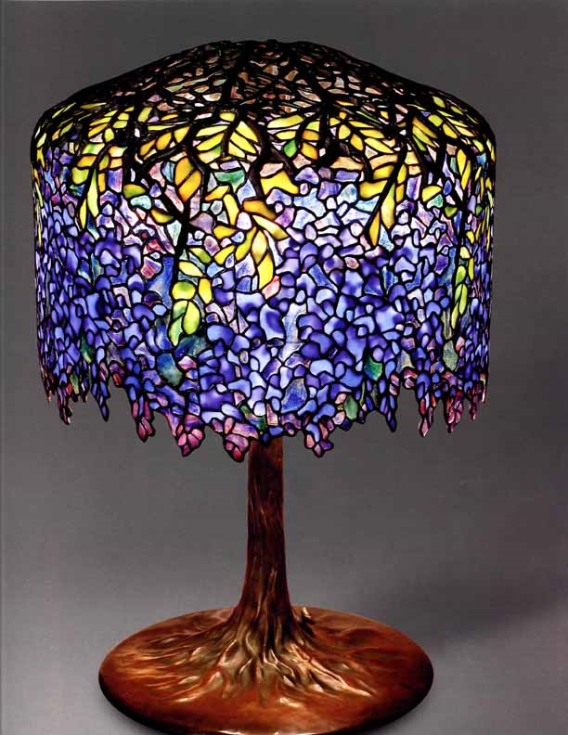

Slide 28
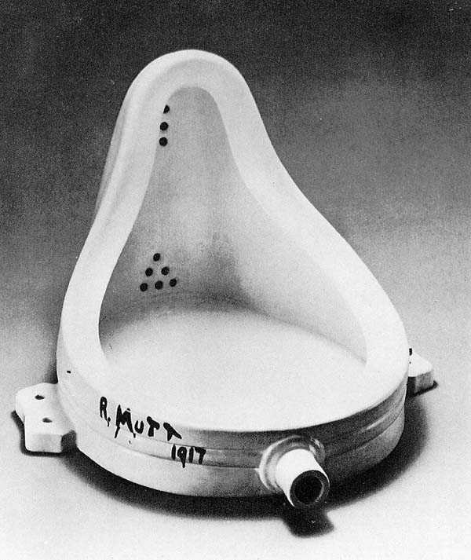
“Dada” Marcel Duchamp Born out of negative horrors of WWI: rejected reason and logic prizing nonsense and irrationality

Slide 29
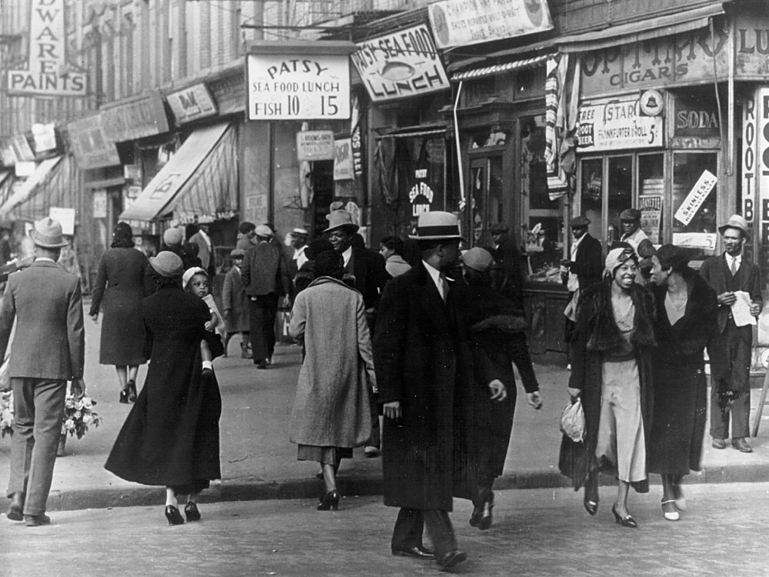

Slide 30
I, Too
BY LANGSTON HUGHES
I, too, sing America.
I am the darker brother.
They send me to eat in the kitchen
When company comes,
But I laugh,
And eat well,
And grow strong.
Tomorrow,
I’ll be at the table
When company comes.
Nobody’ll dare
Say to me,
“Eat in the kitchen,”
Then.
Besides,
They’ll see how beautiful I am
And be ashamed—
I, too, am America.

Slide 31
IX. The Harlem Renaissance – creativity of Black artists and intellectuals in the 1920’s
Reasons
1. Shared history of slavery
2. Inequality and racism
a. Segregation – Jim Crow
b.KKK – lynching's
c.Job and housing discrimination

Slide 32
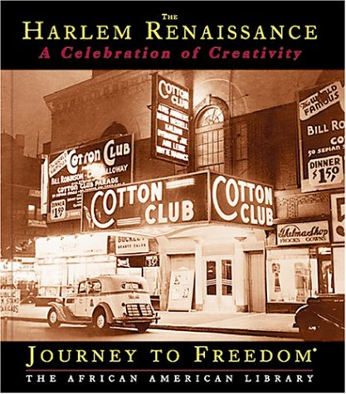

Slide 33
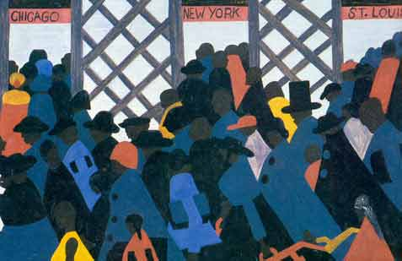
Great Migration during WWI
a. Race Riots

Slide 34
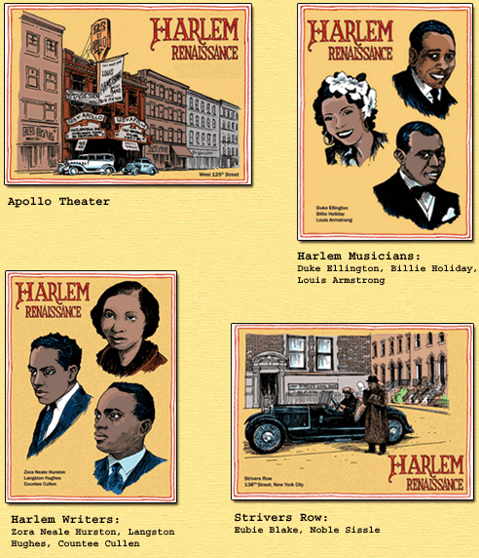

Slide 36
4. NAACP
National Association for Advancement of Colored People
W.E.B. DuBois
Goal: overcome violence and discrimination against Black People

Slide 37
5. Marcus Garvey
“New Negro Movement” – black nationalism
“Back to Africa Movement”-

Slide 38
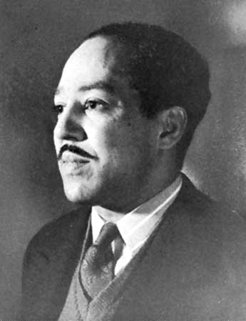
6. Langston Hughes
Poet, writer, social activist
The night is beautiful, So the faces of my people. The stars are beautiful, So the eyes of my people Beautiful, also, is the sun. Beautiful, also, are the souls of my people.
"My People" in Crisis (October 1923)
“The Negro is in vogue”

Slide 39
B. Impact
Redefined how American viewed the African American population
Foundation of civil rights movement
Realization of a unified racial identity, history
Literature appealed to middle-class African Americans and whites

